Slide 1
IEEE CS @ UCF Workshop
Introduction to
Presenter: Harrison Hilpert | Presentation Date: 04/14/2026 | Public Presentation – Free to Share​

Slide 2
Some Quick Footnotes
Zig 0.16 released yesterday!
Some of the information presented may be outdated soon
I will do my best to speculate on how new code may look
This version will take time to permeate through the ecosystem (tools & docs)
Please refrain “out of place” interruptions
I talk fast & technical, slow me down if you don’t understand!

Slide 3
Some Quick Footnotes
This is an introductory workshop, so there will be lapses in detail for the sake of ease or time
Some information will be tagged with an asterisk; this implies there is more going on that may or may not be discussed
This is informal, so proper citation will often be omitted

Slide 4
Some Quick Footnotes
This is an introductory workshop, so there will be lapses in detail for the sake of ease or time
Some information will be tagged with an asterisk; this implies there is more going on that may or may not be discussed
This is informal, so proper citation will often be omitted

Slide 5
Content Ordering
A Tale in Two Parts:
Why to Use Zig?
How to Use Zig?

Slide 6
So,
Why Use ?

Slide 7
What is Zig, Generally?
Zig is a general-purpose programming language designed by Andrew Kelley, announced in February of 2016
The intent of Zig is to be a "more-pragmatic" version of C
There is careful consideration to allow interfacing with C code while not compromising on Zig functionality*
Zig, while being general purpose, has a greater focus and ability to do systems programming tasks

Slide 8
Where is Zig in the Wild?
Zig, by nature of being pre-stable release, doesn't have many major projects at current, but there are some
These are:
Bun Runtime: The runtime for the Bun toolkit is written entirely in Zig
Ghostty: A modern multiplatform terminal emulator
TigerBeetle: A database service specializing in high throughput and speed financial transactions

Slide 9
The Zig Priorities
Pragmatism: Does the language enable or hinder development in a way that could be resolved?
Optimization: The natural way programmers use the language should enable performance better or equivalent to C without compromise on expression clarity
Safety: Performant code may not be ignorant of safe code, and the language should enable safe practices
Readability: Syntax should be concise and easily read

Slide 10
A Naked Man Fears no Pickpocket
Zig, as a philosophy, leaves many important things bare programmer and in their explicit control
No control flow or allocations are hidden* in the standard library or core language, lending more control and encouraging it across the ecosystem
While not having safety mechanisms like RAII or garbage collectors, the tools at your disposal make it easy to solve problems, especially those related to memory

Slide 11
Death to Macros
Zig abandons the C concept of macros and instead introduces 'comptime', a system for performing compile time operations in the same syntax as the rest of the language
Comptime allows for more powerful metaprogramming and internal reflection not possible in C and more elegantly than C++

Slide 12
'C' Integrations
Because Zig is intended to replace C (and sometimes C++), the language ships with a zero-dependency C/C++ compiler based on the LLVM toolchain*
This enables the project to use the benefits of being a Zig project with few, if any, issues, notably the Zig build system
Zig can seamlessly use C source code through @cImport() and external libraries through specifying the calling convention
To handle C integer type variation based on compile targets, Zig provides c_int and usize
C-style strings are also supported, but discouraged

Slide 13
'C' Integrations
Because Zig is intended to replace C (and sometimes C++), the language ships with a zero-dependency C/C++ compiler based on the LLVM toolchain*
This enables the project to use the benefits of being a Zig project with few, if any, issues, notably the Zig build system
Zig can seamlessly use C source code through @cImport() and external libraries through specifying the calling convention
To handle C integer type variation based on compile targets, Zig provides c_int and usize
C-style strings are also supported, but discouraged

Slide 14
Errors
Errors in Zig are essentially values with special properties
Every function and variable can have an error type attached, and can be unwrapped in multiple ways
'try'
'if' statements
'catch'
Errors must be dealt with before the data becomes usable again

Slide 15
A Note on Structs
Structs in Zig are very similar to those in C, with some extra aces up their sleeves that need consideration
Exclusive functions
Reflection
Packing
Alignment
Almost everything in Zig is a struct in some way, so learning them is important to fully maximizing the language

Slide 16
Better Writing DX
Zig works because the language, once past the syntactical differences, feels intuitive to use and drives better practices
The language lends itself very well to DOD (Data Oriented Design) through its simplicity but powerful comptime evaluations
This means the reference frames for how data should be interpreted as it flows through the program adapts with the intent of the programmer, not in spite of it
Difficult or verbose actions in Zig feel intended more to make you consider the weight of data and impact of operations

Slide 17
Now,
How To Use ?

Slide 18
Core Tools
At minimum you need the Zig toolchain available at ziglang.org, providing:
The Zig compiler (& by extension C/C++)
Zig build system handler
Zig standard testing system
Zig package manager
Docgen capabilities
& more
For better experience in editor, zls or other such LSPs are extremely useful but unofficial and sometimes lag behind releases

Slide 19
Learning
There are many different community resources, but check the version, as Zig is ever changing and they are often out of date
The best sources for information is the language refrence and the standard library docs
Zig, as a young language, requires you the student to go read the implementations of the standard library to fully understand what is going on in your code and develop idiomatic habits

Slide 20
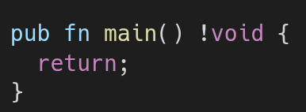
Setting up Main
Zig is very similar to C, but with some minor differences

Slide 21
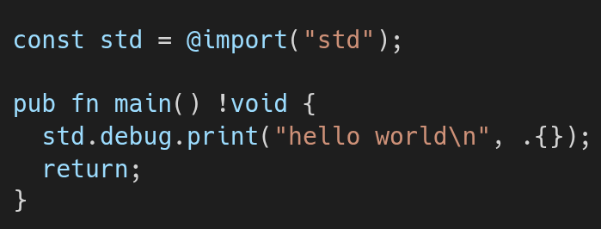
Hello World
Now we bring in the "std" module and use its printing

Slide 22
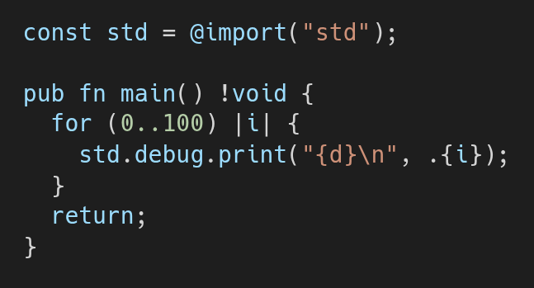
FizzBuzz
This brings some complexity, but not too much
So first, a loop

Slide 23
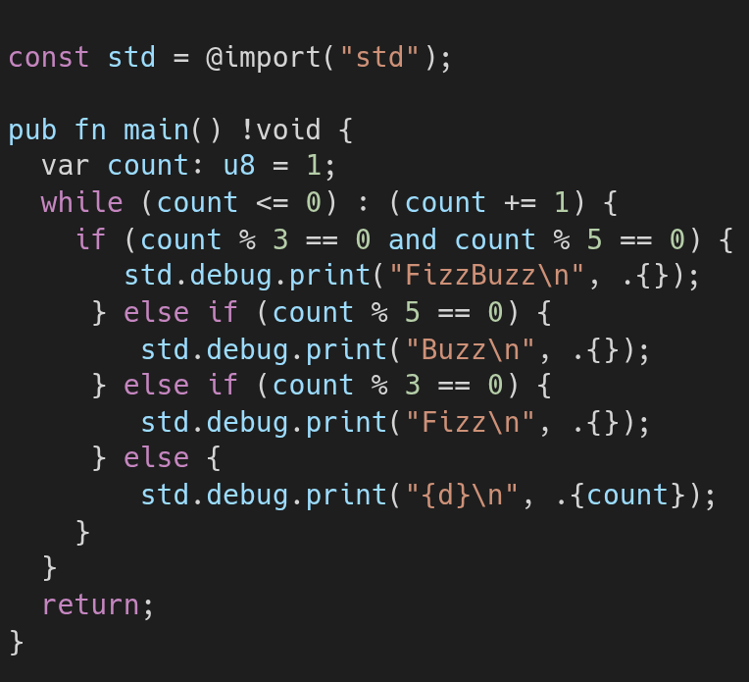
FizzBuzz
Now, some variables & if-else

Slide 24
Thank you for coming!
Any Questions?

Slide 25

Please do Attendance! It helps us a lot!

Slide 27
Header

